Slide 2





















Buildings
Building / Company
Financial building
Building security
Company attack
Company visibility
Energy company
Canadian company
Company intruder
*New* Data building
Factory
Factory security
Factory security check
Factory system config
Factory alert
Factory attack
Hospital
Hospital security
Hospital security check
Hospital system config
Hospital alert
Hospital attack

Slide 3














Business & Management
Briefcase
Toolbox
Interactive tools
Handshake
Non-profit
Healthcare
News media
Justice
Education
Flag
Personal Network
Shopping cart
Consumer goods

Slide 4






Date & Time
Empty calendar
Calendar
Zero Day
Clock
Time cycle
Personal time

Slide 5





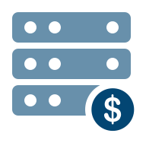














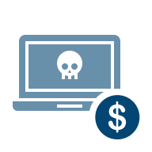
Devices
Hardware
Hardware cancel
Hardware busy
Hardware block
Hardware alert
Hardware cost
Hardware attack
Computer
Computer bug
Computer cloud
Computer intruder
Computer lock
Computer attack
Computer visibility
Computer config
Attack rise
Bug Rise
Attack at random
Laptop security job
Intruder rise
Attack cost

Slide 6











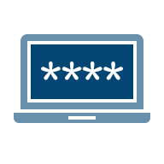


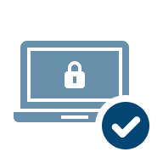


Devices cont.
Block attack
Download malware
Executive media
Device
Device alert
Device location
Device connectivity
Telephone
Email compromise
Email in computer
Computer data
Computer password
Screen
Media screen
Security check computer
*NEW* Desktop Computer
*NEW* Desktop Computer Security

Slide 7
















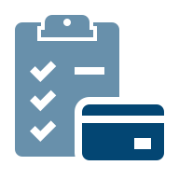




Documents
Document
Document settings
Document alert
Documents
Documents search
Encrypted documents
Document check
Document information
Edit document
Document service
Clipboard
Checklist A
Security checklist
Checklist B
Checklist decrease
Checklist increase
Credit card checklist
Folders
Folder expansion
Folder search
User folders

Slide 8







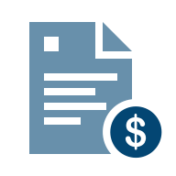

Documents cont.
Checklist increase B
Mail envelope
Open mail
Mail increase
Phishing
Infected email
Checklist search
PDF document
Financial document
*NEW* Certification

Slide 9



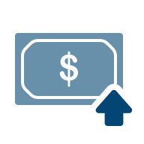









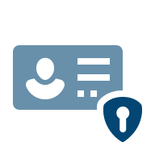

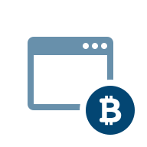
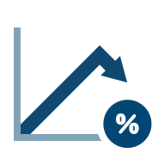

Financial
Finance Dollar
Financial decrease
Dollar
Dollar increase
Dollar decrease
Financial alert
Paycheck
Paycheck increase
Chart
Cryptocurrency
Crypto bag
Money bag
Personal ID
ID security
Credit card
Bitcoin app
Percentage chart
Financial chart

Slide 10




Financial
Insurance decrease
Insurance increase
Insurance
Cybersecurity insurance

Slide 11
















People Groups
Partners
Team
Board members
Attacker group
Training presentation
*NEW* Projection
Security partners
Security team
Security board members
Board communication
*NEW* Team Increase
Security team alt.
Team systems
Board member alert
Board
*NEW* Team Decrease

Slide 12






Individual People cont.
Attacker
Unknown attacker
Attacker alert
Fewer attackers
More attackers
Hacktivist

Slide 13

















Security & Privacy cont.
Security shield B
Security visibility
Security finance
Security shield lock
Security questions
Security shield check
*NEW* Security Increase
*NEW* Security Decrease
Attack
Attack system
Attack search
*NEW* Attack Decrease
*NEW* Attack Increase
GDPR
Secure connection
Malicious attachment
Secure WiFi

Slide 14


















Social Media *NEW*
*NEW* Facebook
*NEW* Twitter
*NEW* YouTube
*NEW* LinkedIn
*NEW* Instagram
*NEW* TikTok
*NEW* Snapchat
*NEW* WhatsApp
*NEW* Zoom
*NEW* Pinterest
*NEW* Reddit
*NEW* Discord
*NEW* Telegram
*NEW* Tumblr
*NEW* Skype
*NEW* FB Messenger
*NEW* Slack
*NEW* Tinder

Slide 15




















Symbols & Concepts
Cancel
Alert
Alert badge
Question badge
Halt badge
Cross
Target
Eye badge
Eye
Cross badge
Prohibited A
Prohibited B
Random
Bucket
Down arrow
Left arrow
Right arrow
Up arrow
Configuration
Configuration check

Slide 16















Symbols & Concepts
Search
Person search
Person search increase
Gender
Target sights
*New* Location Pin
*New* Attachment
Lightbulb on
Lightbulb off
Lightbulb alert
Speech bubble
Communication alert
*New* Communication alert 2
Lightbulb config
Loudspeaker

Slide 17




















Technology
Database
Database attack
Data tagging
Location data
Healthcare data
Data alert
Data block
Artificial Intelligence
AI vehicle
AI financial
Biometric fingerprint
Biometric broken link
Biometric security
Biometric access denied
Website
Interactive website
Ransomware
Application Security
Location-based Ad
Compromised Website
*New* Website payload

Slide 18





















Technology cont.
Cloud
Cloud security check
Cloud vehicle
Cloud systems
Cloud expansion
Cloud strategy
Cloud lock
Cloud visibility
Cloud architecture
Cloud data
Cloud documents
Empty cloud
Cloud attack
Cloud search
Email inbox
Open mail
Malicious email
IoT
IoT lock
IoT security check
AWS security check

Slide 19









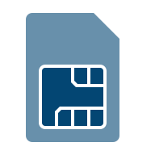

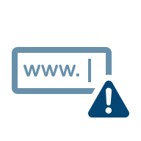





Technology cont.
Media
Settings
Headset
Support increase
Idea protection
Password unauthorized
Password security
WiFi
Interactive link
SIM card
SIM swapping
Domain alert
Web domain
Blockchain
*New* Interactive application
*New* Mouse pointer
*New* Video
call alert

Slide 20







Transportation
Truck
Truck security
Truck insurance
Airplane
Steering wheel
*NEW* Car
Loaded truck

Slide 21
U.S. Map

Slide 22
World Map

